Slide 1
MSc in Big Data Management & Analytics Applied Data Analytics
Online Retail Dataset
<PRONOY DSA
2952742>

Slide 2
Dataset Description
A multinational dataset containing the history of all the transactions taking place between December 1, 2010 & December 9, 2011 for a UK-based & registered non-store online retail corporation.
The company mainly sells unique all-purpose items or inventory. Most of the customers of the company are wholesalers.

Slide 3
Exploratory Analytics & Visualization of Data
To analyze Online Retail Dataset to summarize its main characteristics, with visual methods.
To identify outliers, trends & patterns.

Slide 4
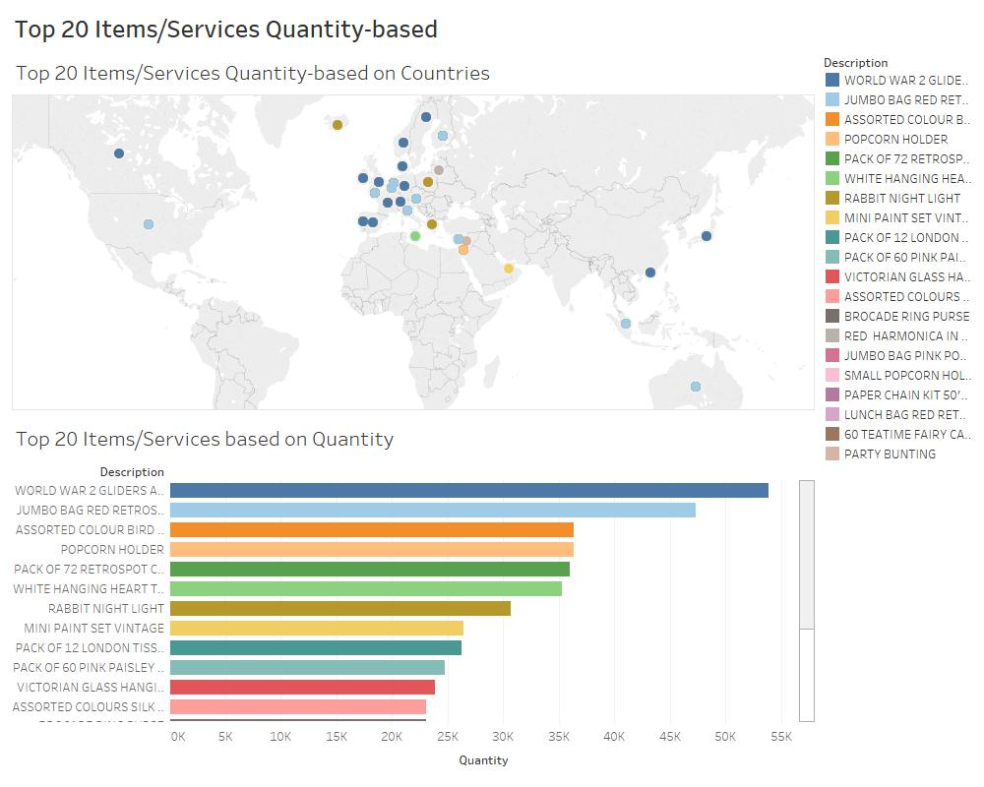
Dashboard 1:

Slide 5
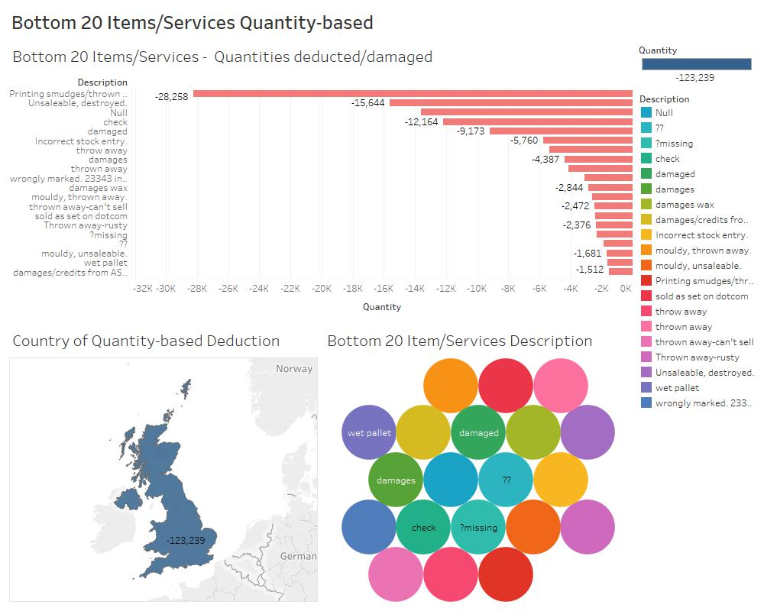
Dashboard 2

Slide 6
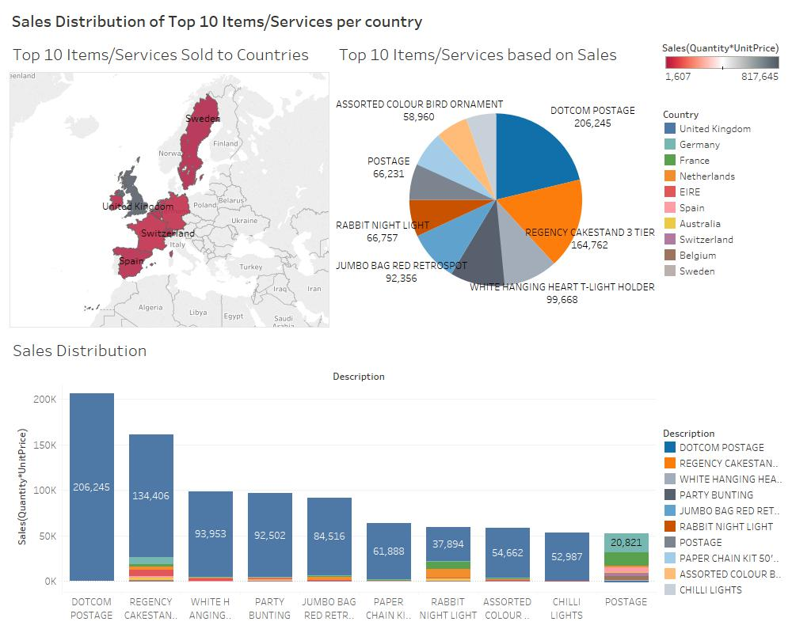
Dashboard 3

Slide 7
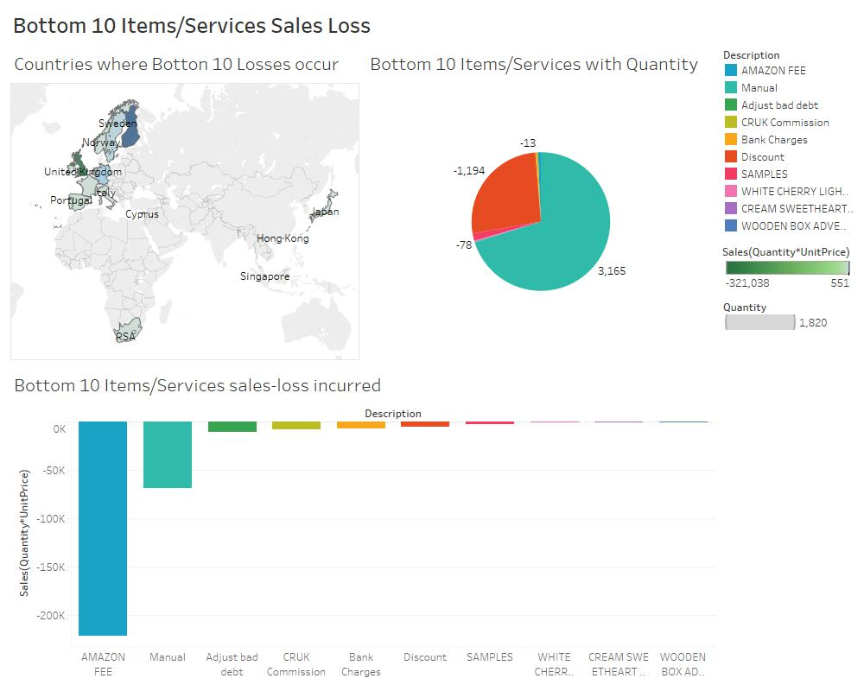
Dashboard 4

Slide 8
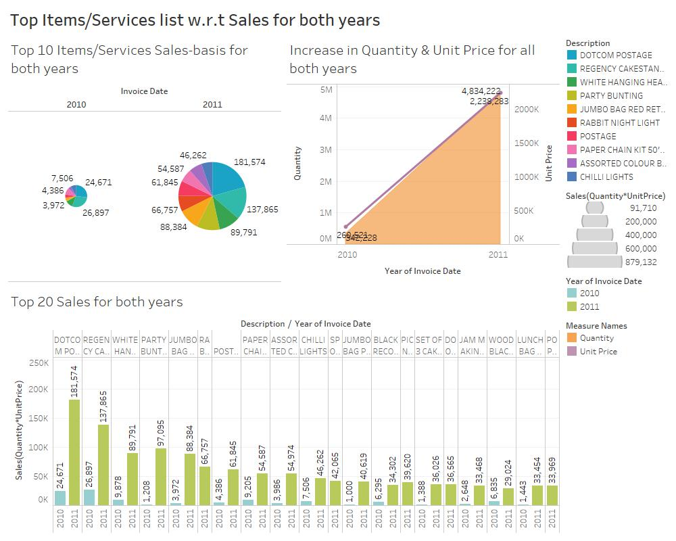
Dashboard 5

Slide 9
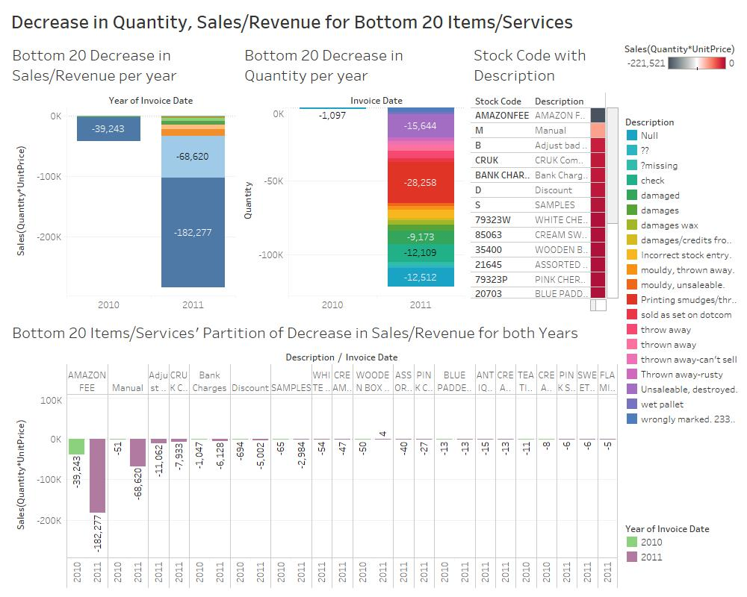
Dashboard 6

Slide 10
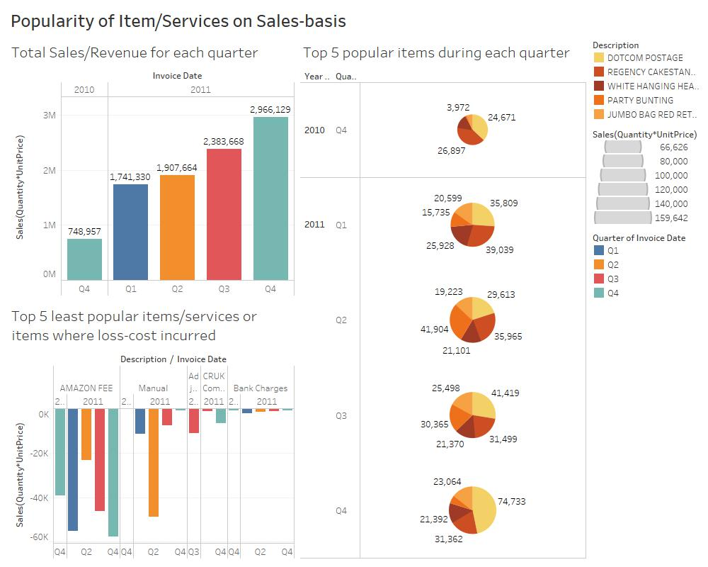
Dashboard 7

Slide 11
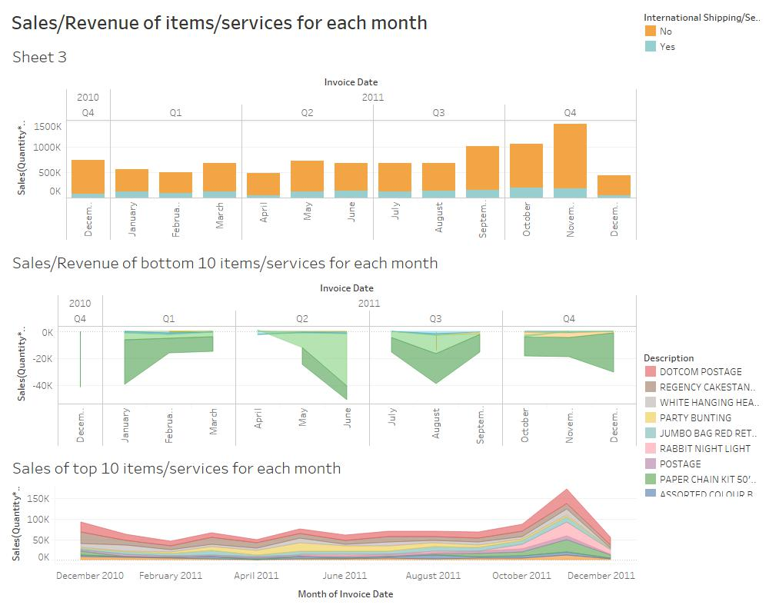
Dashboard 8

Slide 12
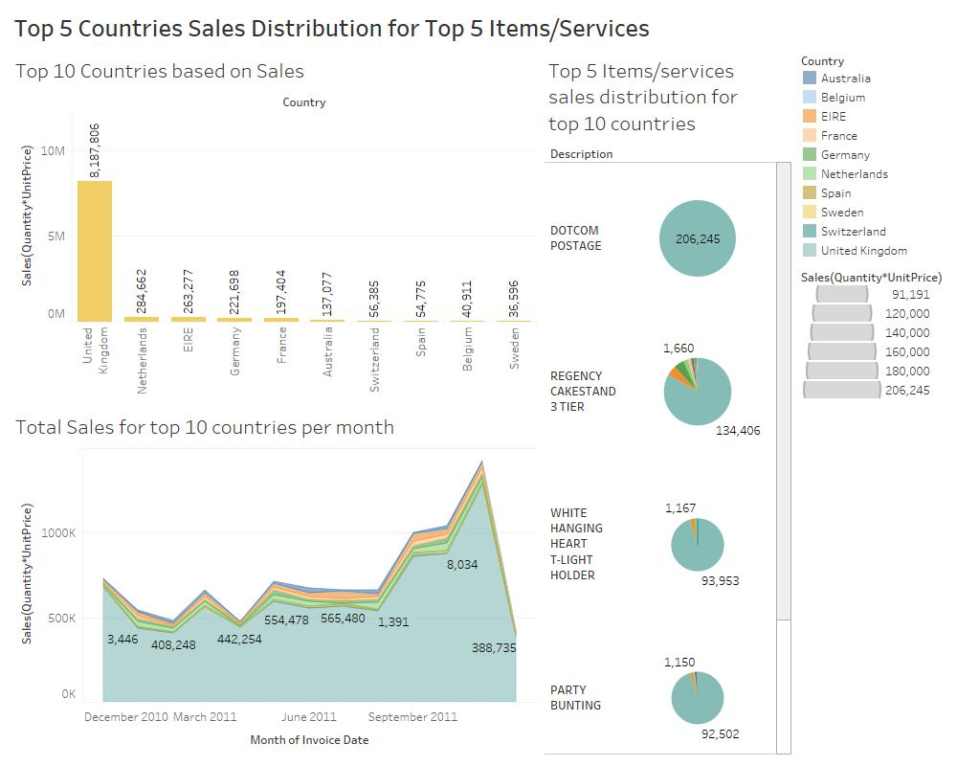
Dashboard 9

Slide 13
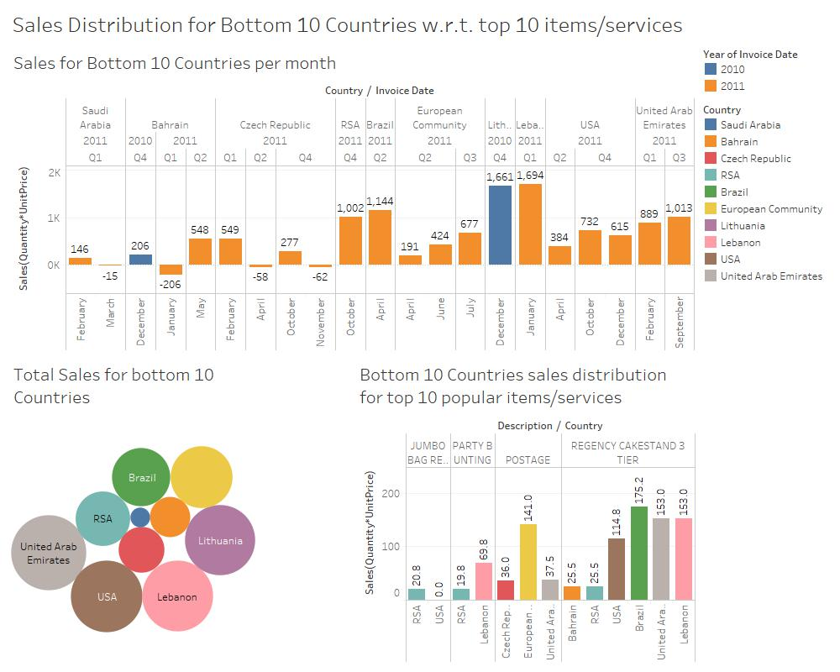
Dashboard 10

Slide 14
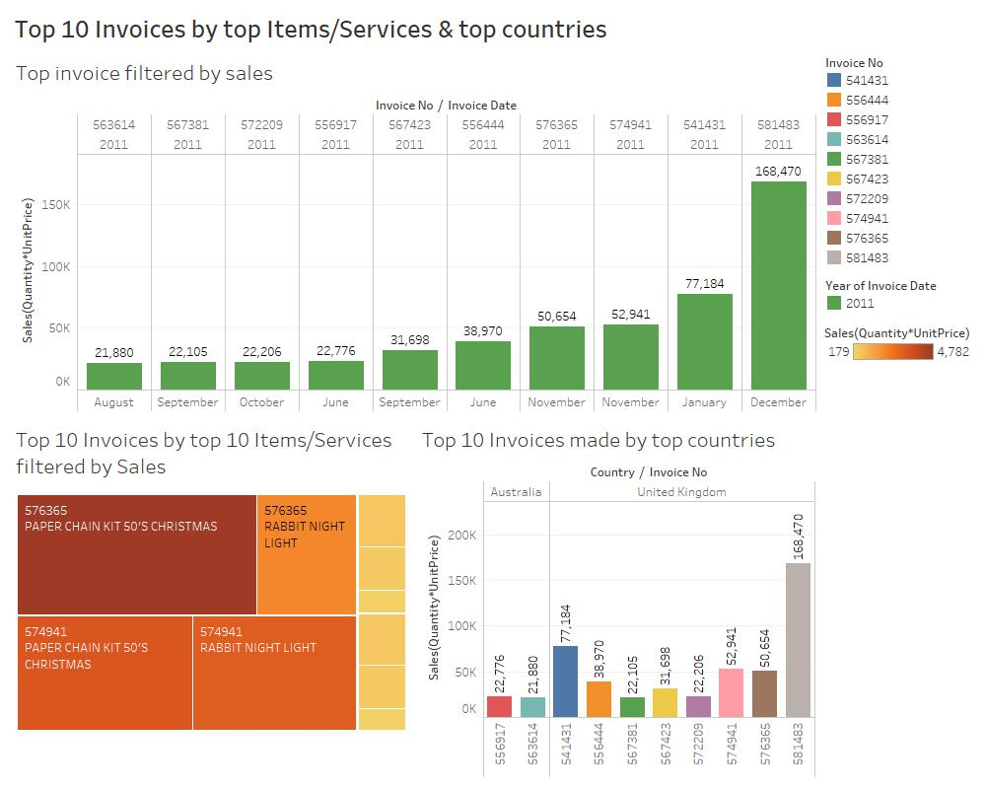
Dashboard 11

Slide 15
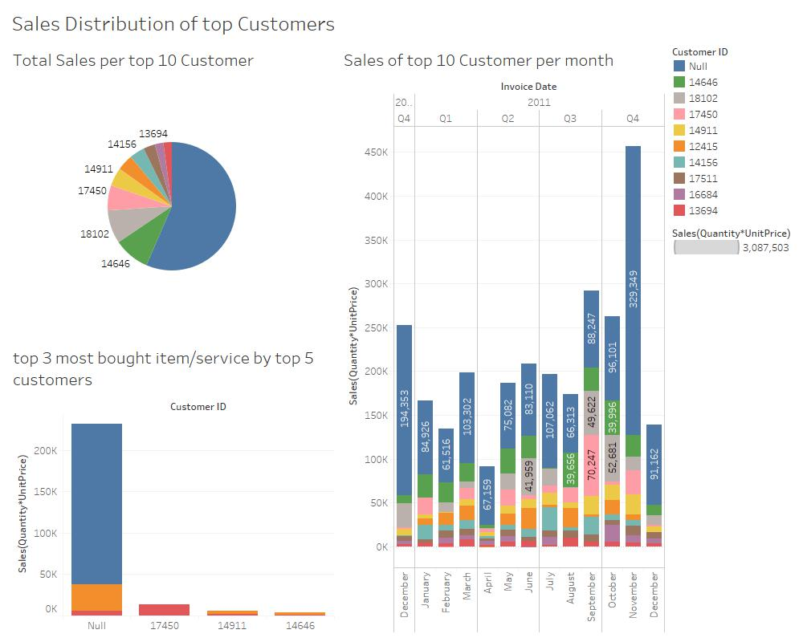
Dashboard 12

Slide 16
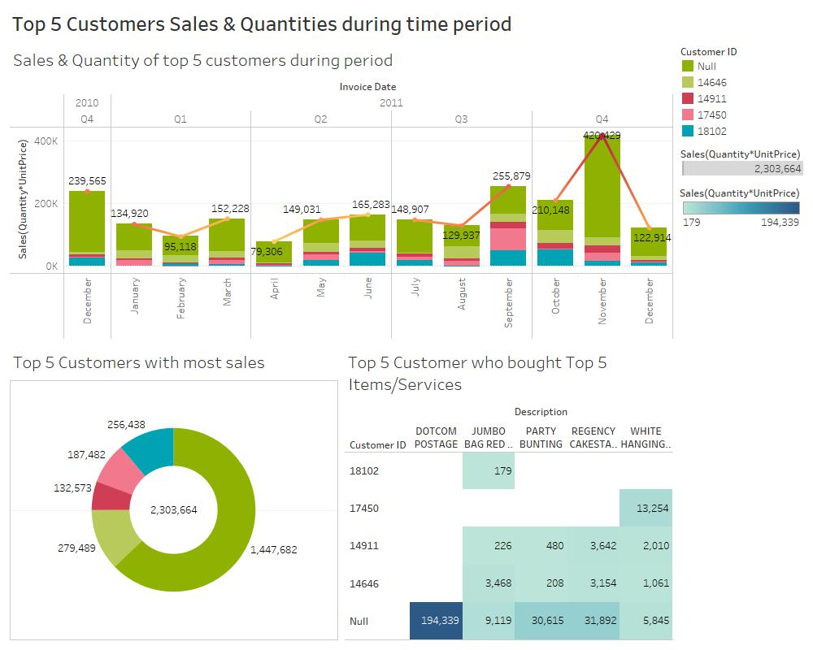
Dashboard 13

Slide 17
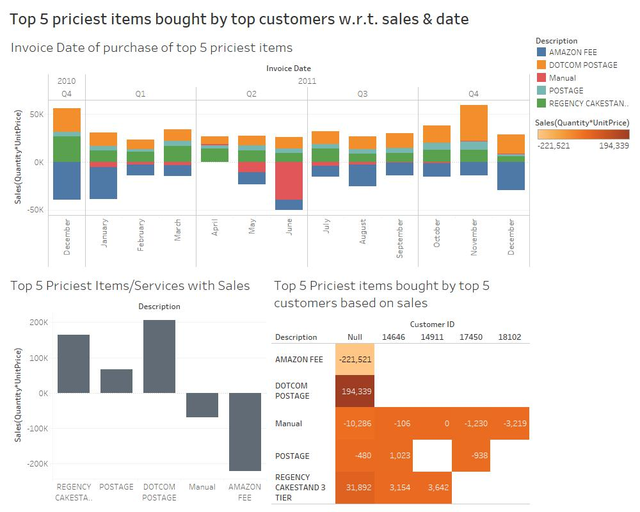
Dashboard 14

Slide 18
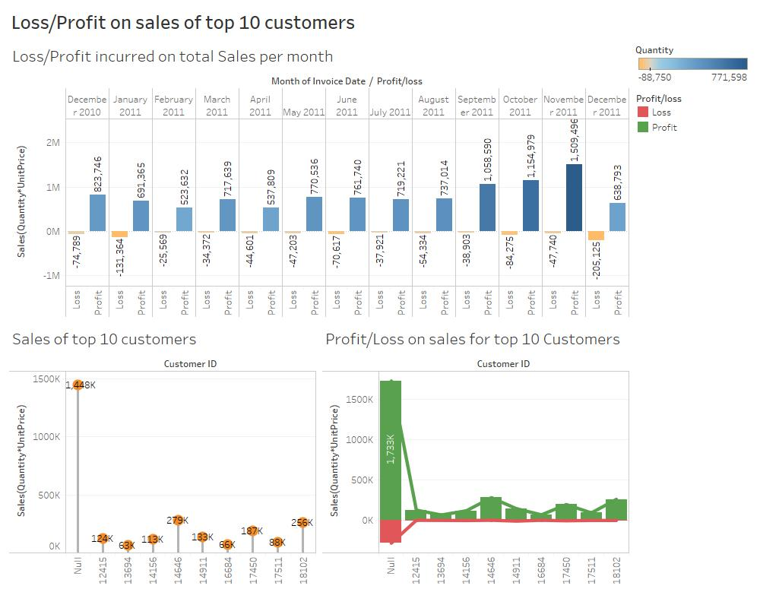
Dashboard 15

Slide 19
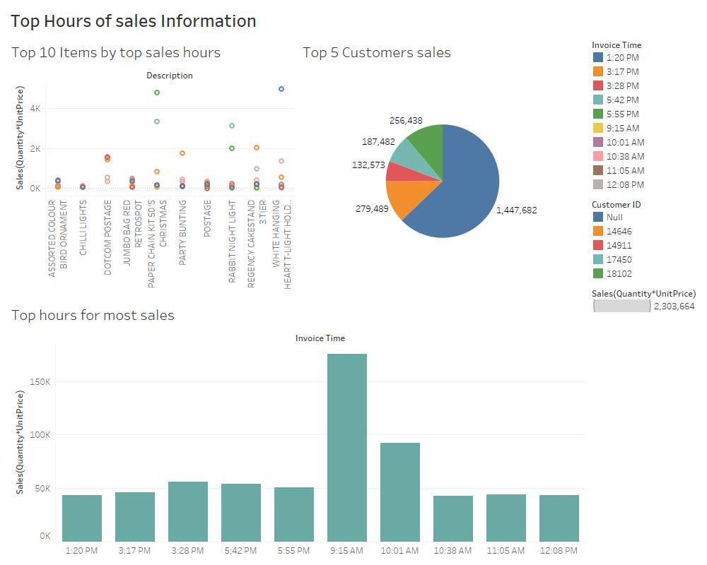
Dashboard 16

Slide 20
Predictive Analytics
It helps connect data to effective actions by drawing reliable conclusions about current conditions & future events.
The business – Online Retail Store will be able to use predictive models to exploit patterns found in historical data to identify potential risks & opportunities before they occur.

Slide 21
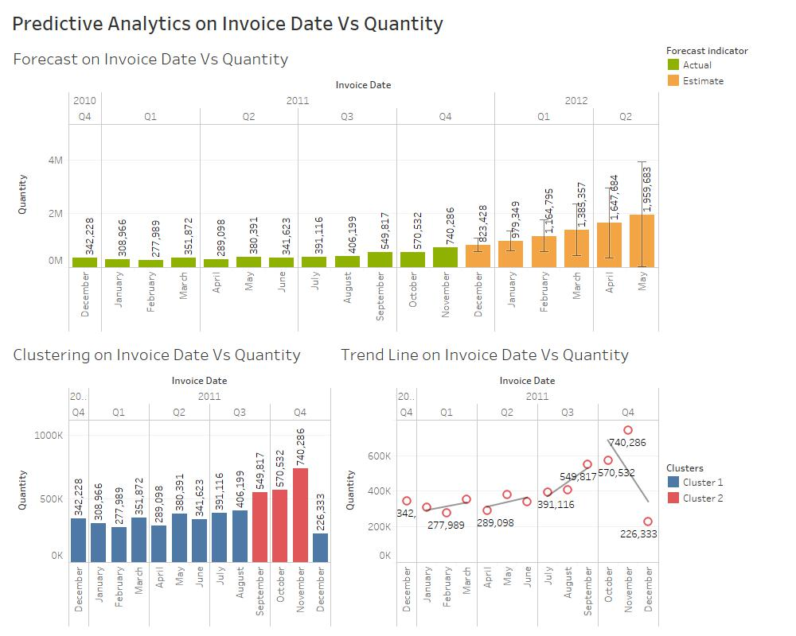
Predictive Analysis 1

Slide 22
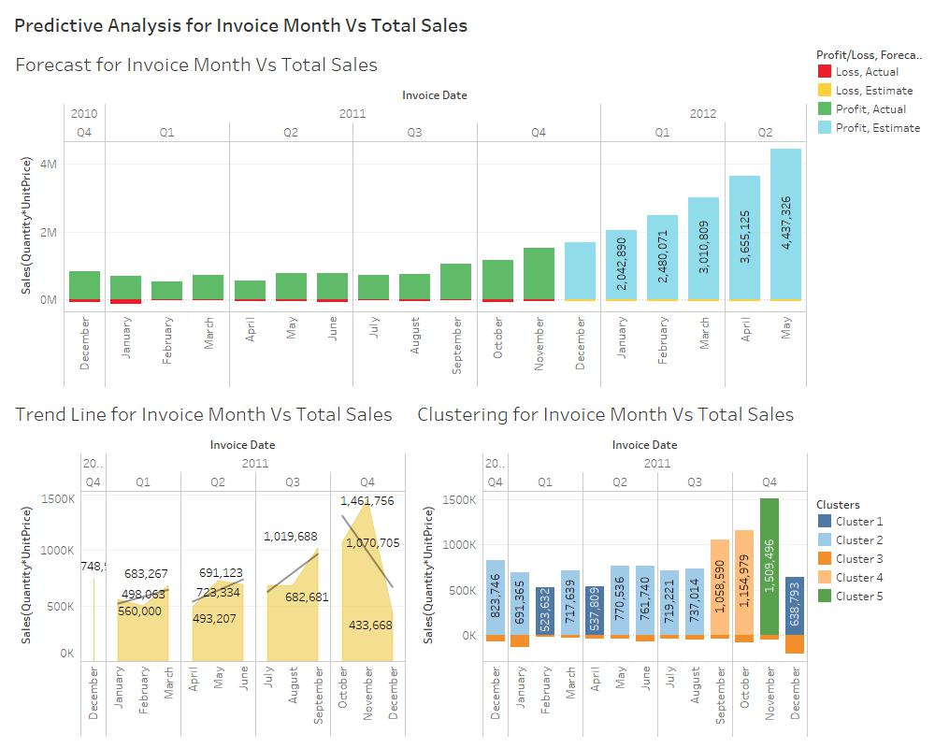
Predictive Analysis 2

Slide 23
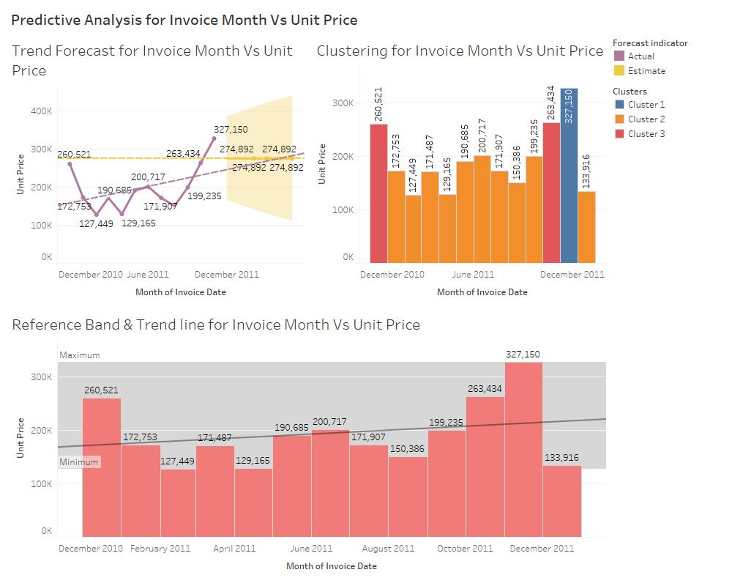
Predictive Analysis 3

Slide 24
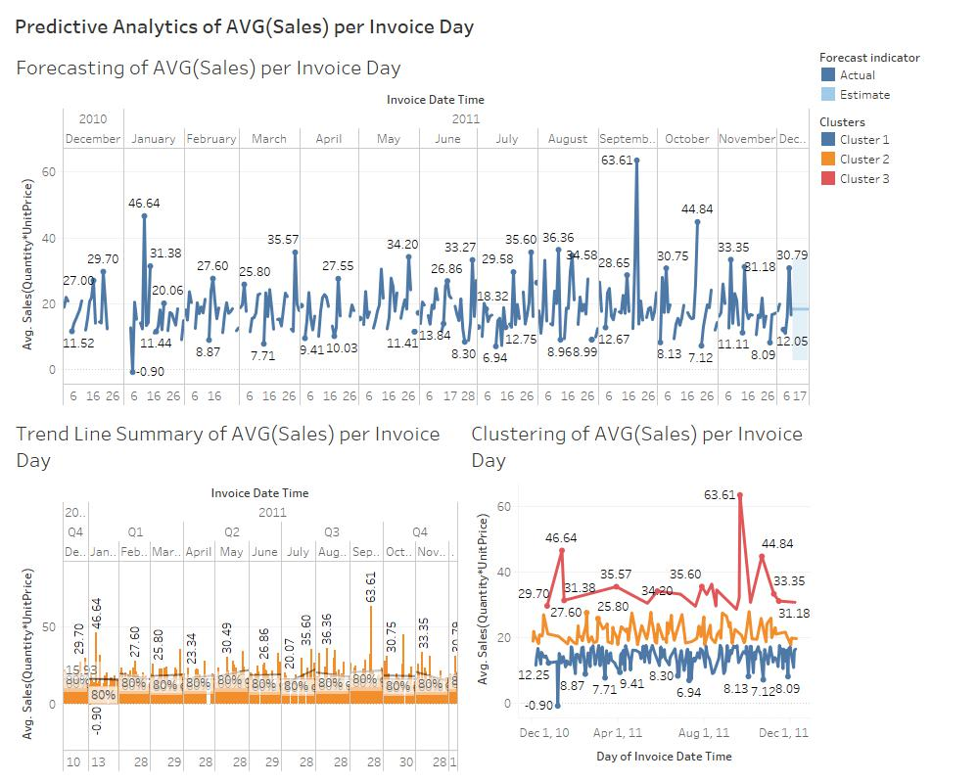
Predictive Analysis 4

Slide 25
THANK-YOU!

